Slide 1

A PROJECT REVIEW PRESENTATION
ON
DEVELOPMENT OF VIRTUAL ENVIRONMENT
FOR AN
ASSEMBLY OF MACHINE COMPONENTS
by
S MOHITH 16121A03D7
Y VIJAY SAI NATH 16121A03F8
A ARAVIND 17125A0302
B SAI LOHITH 17125A0305
D VASIF HUSSAIN 17125A0314
G JAYA PRAKASH REDDY 17125A0317
under the guidance of
Dr. K.L.NARASIMHAMU
Professor
DEPARTMENT OF MECHANICAL ENGINEERING
SREEVIDYANIKETHAN ENGINEERING COLLEGE
(Affiliated to J. N. T. University Ananthapur, Anantapuramu)
Sree Sainath Nagar, Tirupati-517 102(A.P)
2016-2020

Slide 2
ABSTRACT
Virtual Reality(VR) provides an interface that enables to train the users and improve their skills using virtual environment. This virtual environment is developed by using Unity 3D. This project(Development of virtual environment for an assembly of machine components ) is inclined to experience richer and more engaging learning experiences that can be provided through books, websites or even videos. It immerses the user in a 3D interactive experience that allows interactive learning in a controlled and safe environment.

Slide 3
OBJECTIVE
To create a virtual environment before moving to practical assembly of an engine.
To replace physical models by creating them in virtual reality platform.
To enhance better understanding and visualization of the engine assembly.
To reduce the learning and training time.

Slide 4
INTRODUCTION
Human history is marked by a progression of media used to convey and experience ideas. Perhaps the most recent step in progression is the use of virtual reality(VR).
Virtual Reality simulates a user’s physical presence in an artificially created world and allows them to interact with the virtual environment.
Four key elements of virtual reality experience:
Virtual world
Immersion
Sensory feedback
Interactivity

Slide 5
In this immersive, interactive, training experience can be created that intern increases the speed and efficacy of knowledge transfer while reducing dependency on physical proximity.
Unity is a game developing engine used to create 2D,3D, virtual reality, and augmented reality games and offers a primary scripting in C#.

Slide 6
LITERATURE SURVEY
Recorded history begins with people paintings on cave walls. These paintings were a primitive medium for conveying the artist’s concept.
It all started in 1989 when Jaron Lanier, founder of VPL Co. came up with the phrase "Virtual Reality", which became the title for this scientific technology field[1].
In the 19th Century, the first 360-degree art through panoramic murals began to appear. Nearly one hundred years later, a mechanical device, the Sensorama, engaged multiple senses to create an immersive VR. The system provided a multisensory experience of riding a motorcycle, including three-dimensional, full-color film together with sounds, smells, and the feeling of motion, as well [2].

Slide 7
Use of virtual reality (VR) in education can be considered as one of the natural evolutions of computer-assisted instruction (CAI) or computer-based training (CBT) [3].
Nooriafshar et al. (2014), has proposed the importance and effectiveness of visual features in teaching and learning materials. virtual reality multimedia could enhance learning by providing much more realistic images and visual features [4].
Chris Christou (2015), has explained that A key feature of VR is that it allows multi-sensory interaction with space visualized. This combination of multi-sensory visualization and interactivity make VR ideally suited for effective learning [5].

Slide 8
Xueqin Chang et al. (2016), have been described that Virtual reality technology as a new kind of remote education media technology, with its powerful teaching advantages and potential, is bound to vigorously promote the informatization development process of distance education [6].
Reworking a physical model can take weeks, but reworking a virtual prototype can take only minutes [7].
Having a VR simulation is always something that is very cool and motivates students to give it their best. As well, VR training is more economical, ecological, and efficient [8].

Slide 9




EXPERIMENTAL SETUP
FLOW CHART
CATIA V5
PIXYZ STUDIO
UNITY 3D & VISUAL STUDIO
OCULUS GO

Slide 10
METHODOLOGY
Objective:
To develop a VR application that gives complete learning, training, and finally self -evaluation of the student.
The progress of this project shows in three stages namely: 1. Design
2. Develop
3. Deploy
Tools used:
1. Catia v5 – Cad Design Software.
2. Pixyz Studio – Digital Content Creation (3D) Tool.
3. Unity3D – Game Development Platform.
4. Visual Studio – Integrated Development Environment.
5. Oculus Go – A standalone VR Headset.
This application is in three modes namely: 1. Learning
2. Training
3. Self- Evaluation

Slide 11
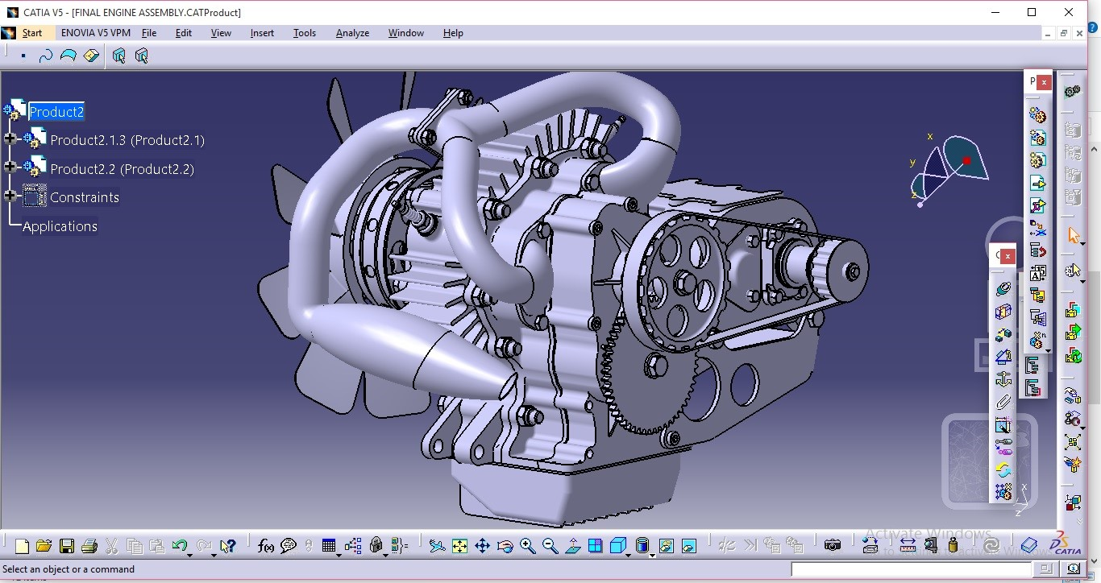
Design , Develop and Deploy for VR
DESIGN : CATIA -V5
3D MODEL OF AN ENGINE ASSEMBLY

Slide 12
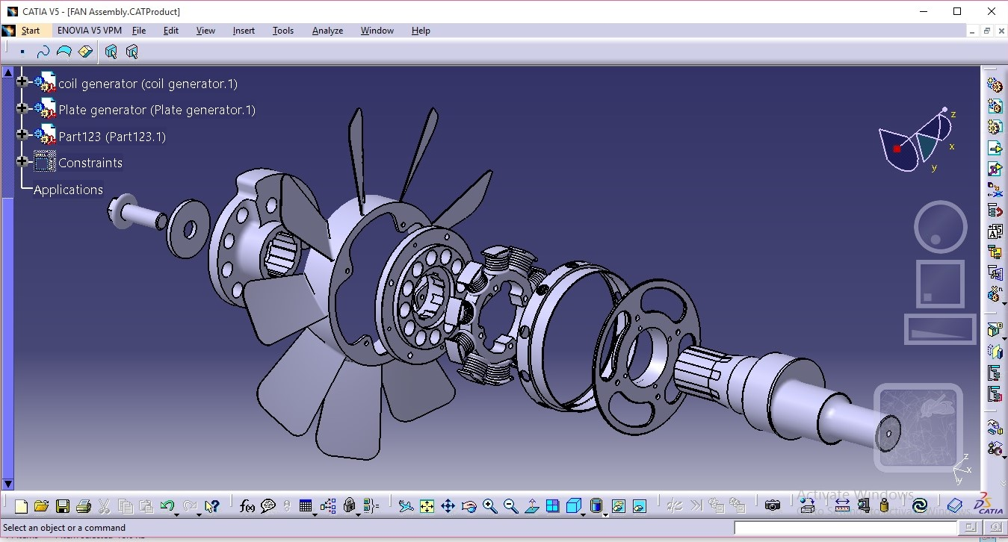
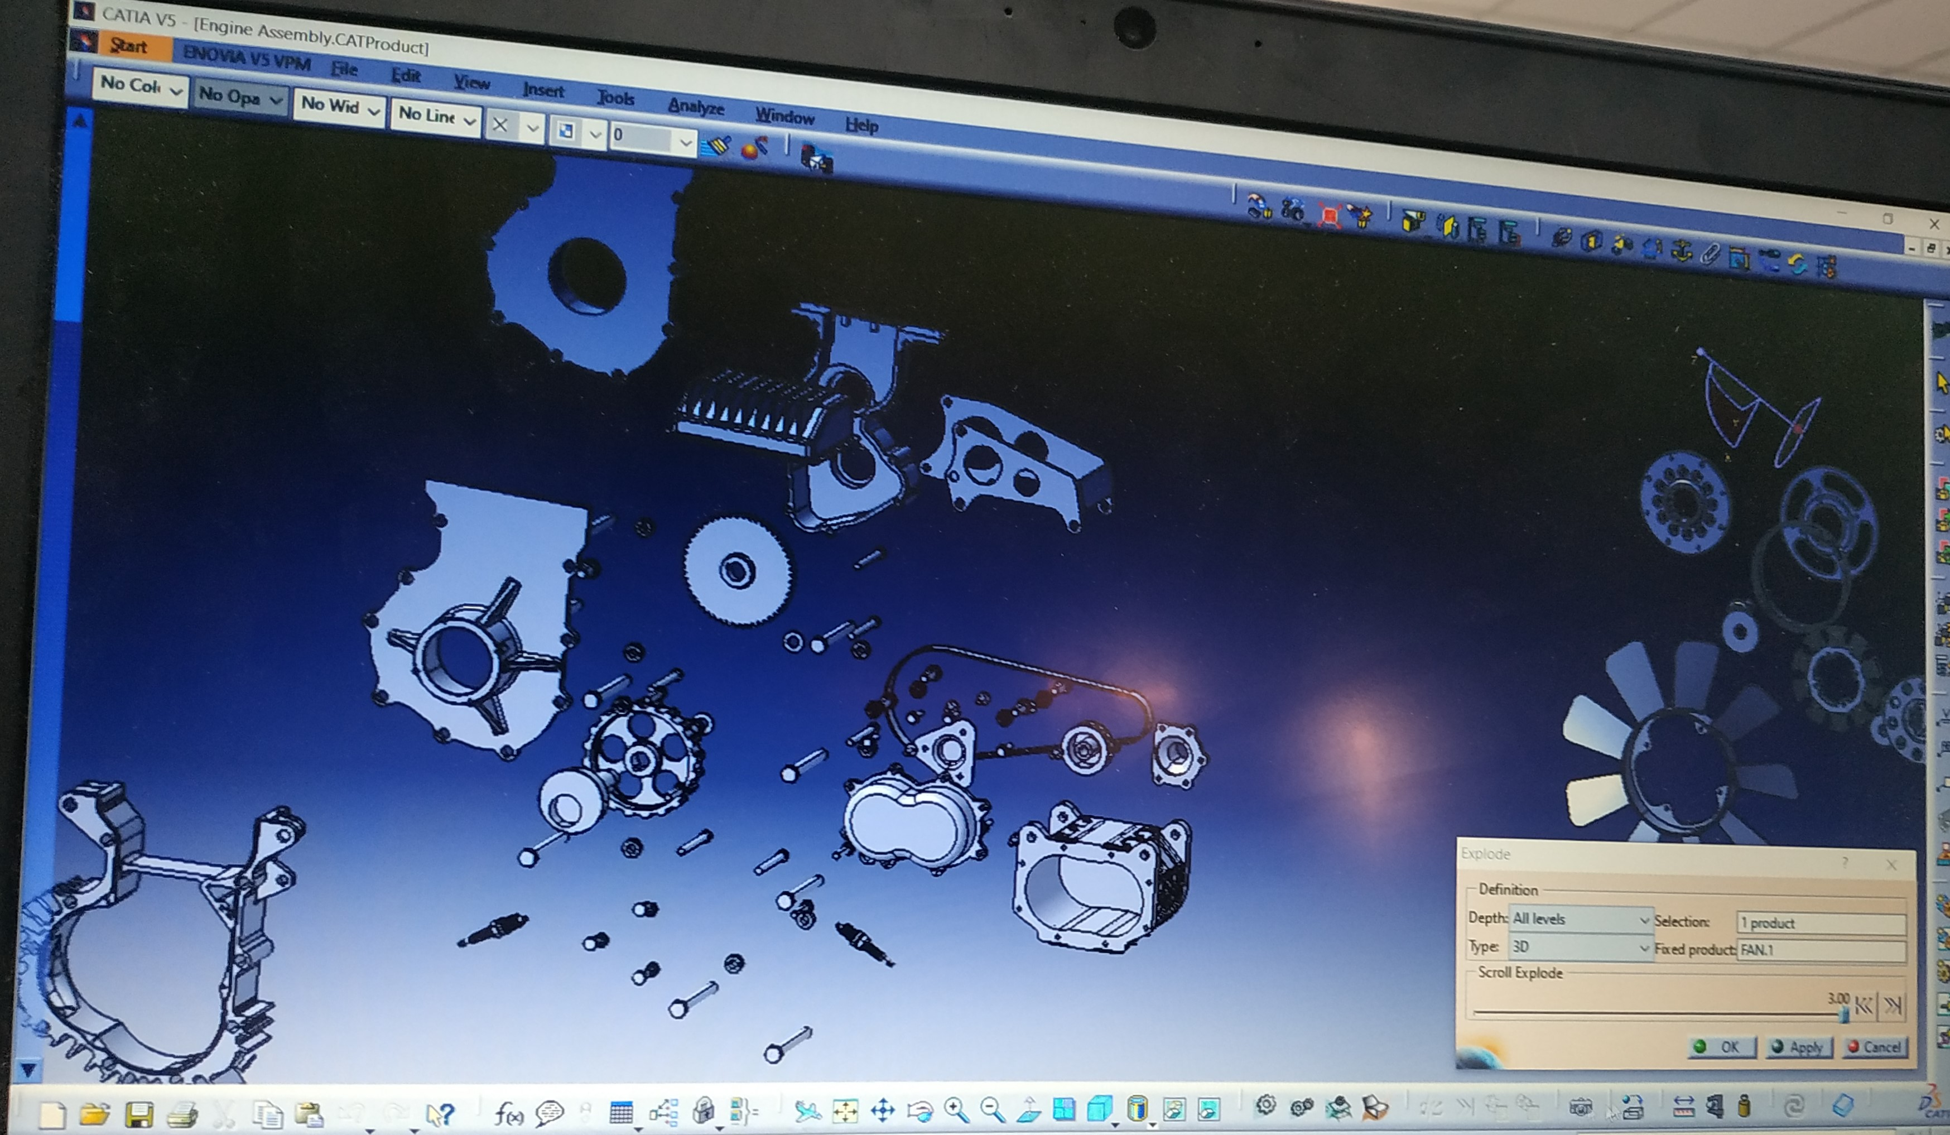
GEAR ASSEMBLY
HOUSING ASSEMBLY
EXPLODED VIEW OF THE SUB ASSEMBLIES

Slide 13
3D DATA PREPARATON TOOL: PIXYZ STUDIO
Creates high quality and low density meshes from almost any CAD model.
CAD file import Repair CAD(to prevent non-assembled CAD elements) Tessellation(for surface mesh generation)
Model Repair(faces orientation, unification, topology correction) Invert orientation(all the faces of the model in same direction).
To get a low-poly model for a virtual reality usage
Remove Holes – Surfacic holes-may reseal due to a tessellation failure.

Slide 14
Hidden Removal – To remove all hidden parts, patches and polygons which are not necessary for the visualization.
Remove the link with CAD patches – To allow the re-meshing over patches boundaries(delete patches).
Decimation – It reduces the polygon density of a mesh by deleting vertices. It allows precise control, preserving normal distortion and texture coordinates.
Export the model – The model has been optimised for a real-time usage, such as Virtual or Augmented Reality.

Slide 15
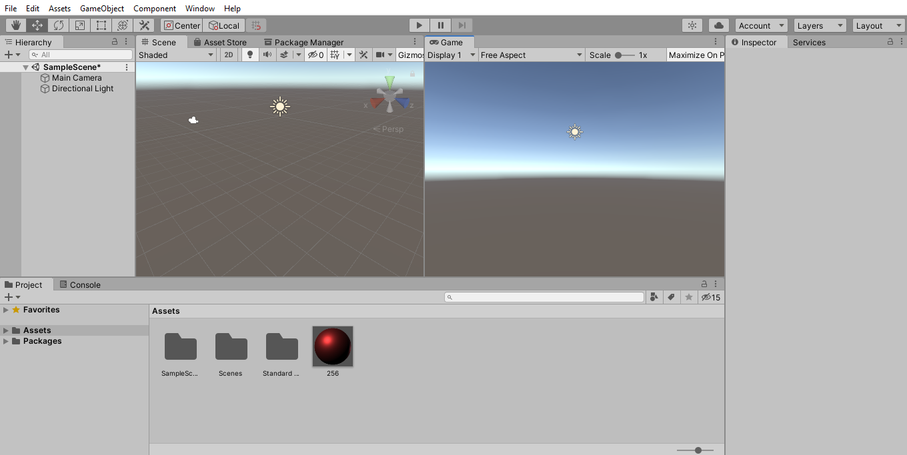
DEVELOP: UNITY 3D
GAME
HIERARCHY
SCENE
INSPECTOR
UNITY EDITOR INTERFACE
PROJECT

Slide 16
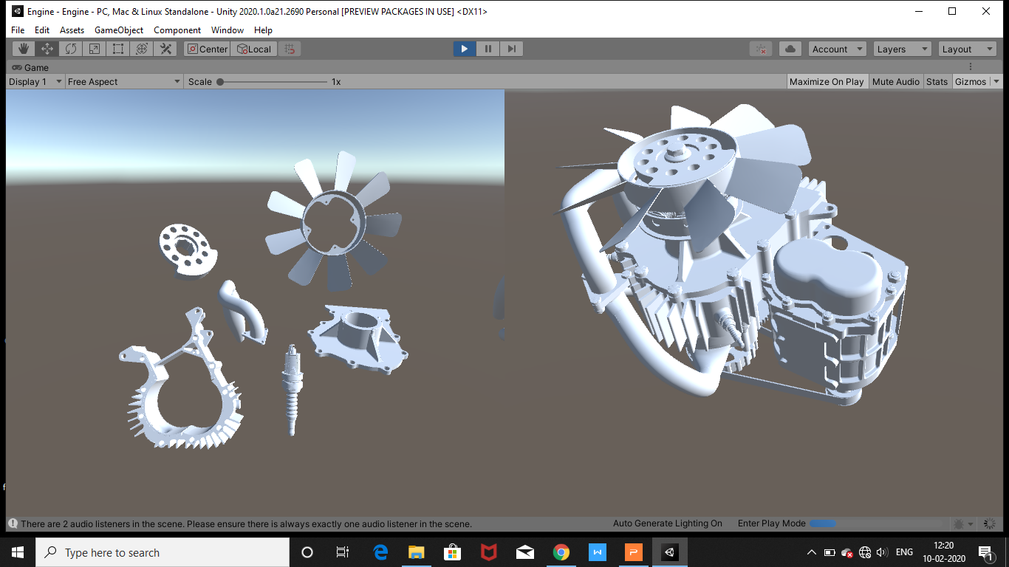
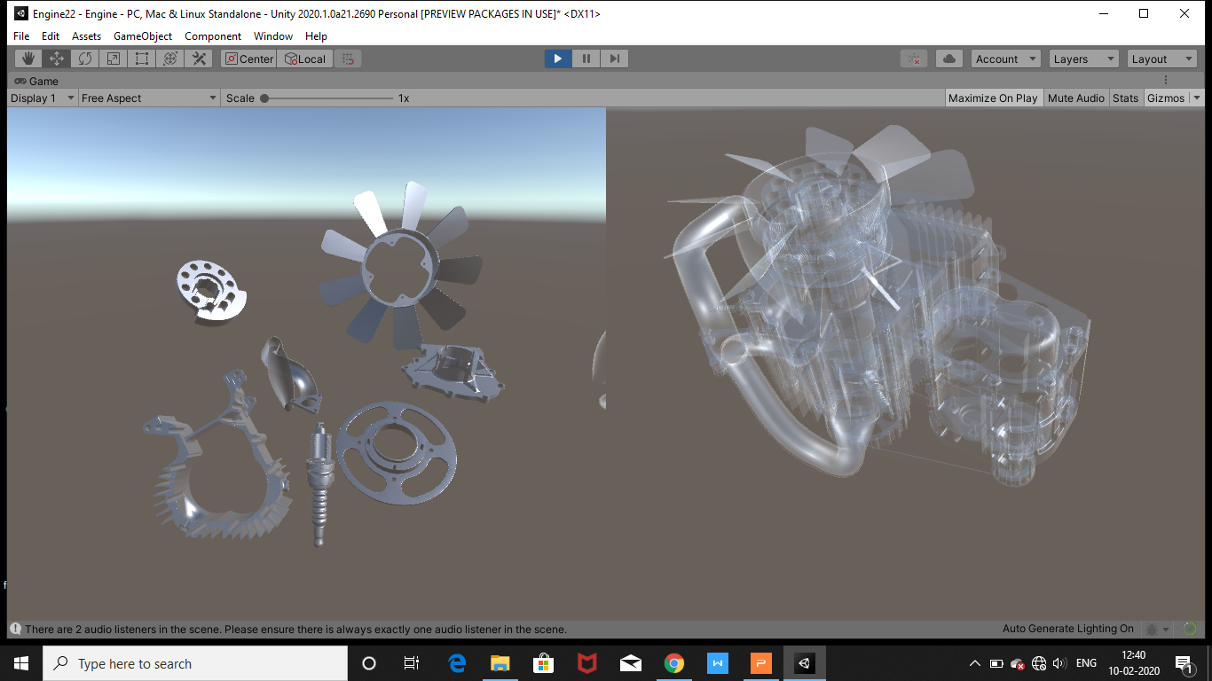
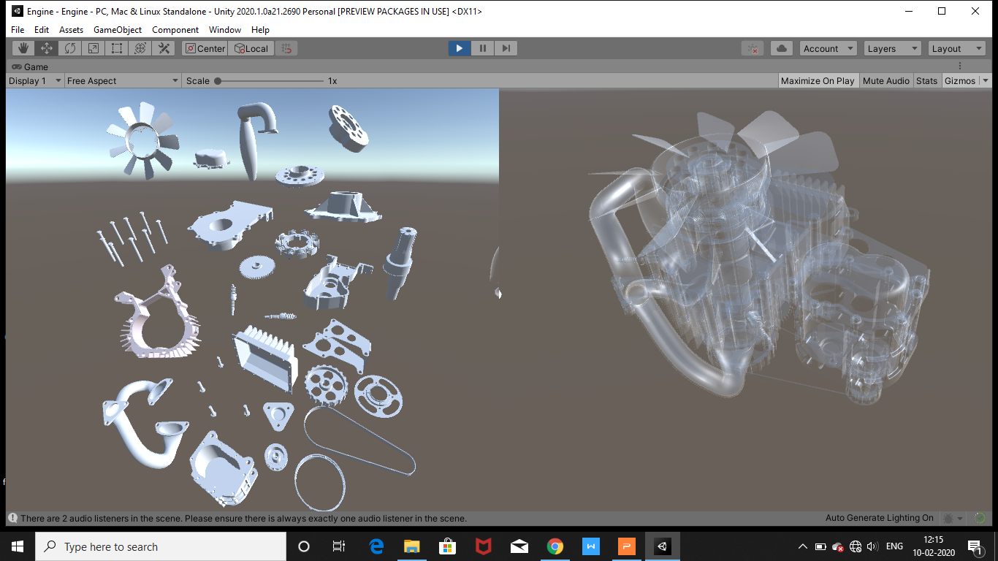
STEP-1
STEP-2
STEP-3

Slide 17
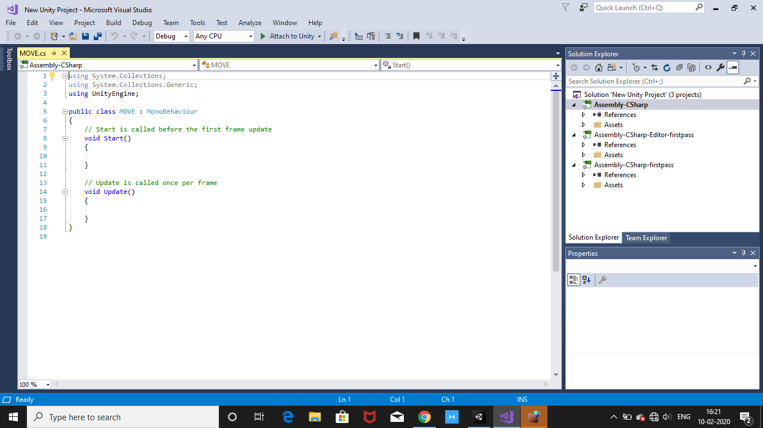
SCRIPT: VISUAL STUDIO
BASIC C# CODE

Slide 18
DEVELOPMENT OF THE APPLICATION
In unity (version:2019.3.5f1) the required environment is created.
In learning mode, it will be shown both the engine assembly and individual components of the engine. It will give a complete understanding of the construction of an engine.
In training mode, we changed the select script to drag-and-drop script. All the parts should be placed in the correct position and make the complete engine assembly.
In self-evaluation mode, we hide the main engine assembly. According to the number of parts assembled in correct position, can evaluate the student's performance and their understanding of the concept. Finally, it will give a score, this will motivate the students to perform well in the examination.

Slide 19
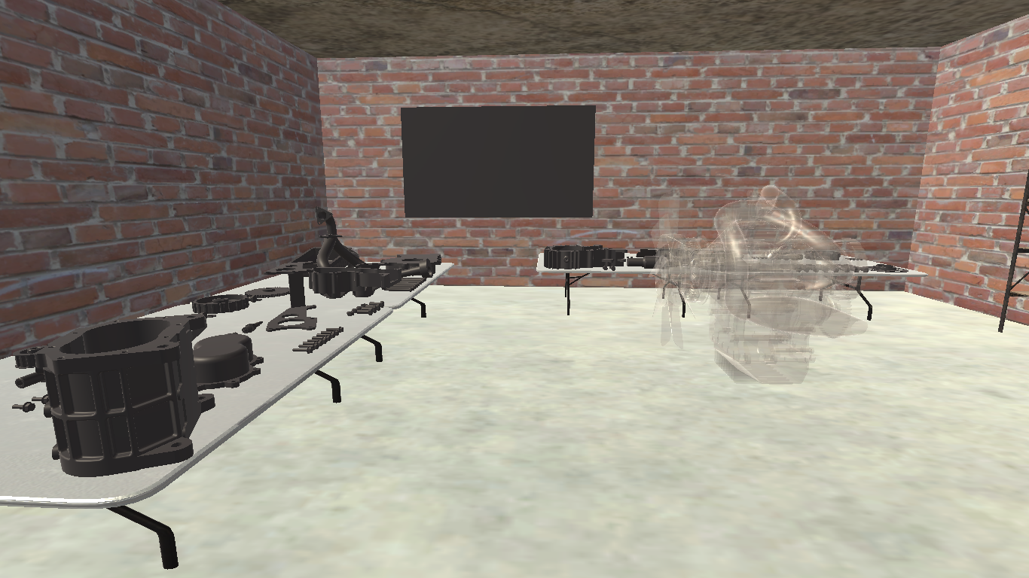
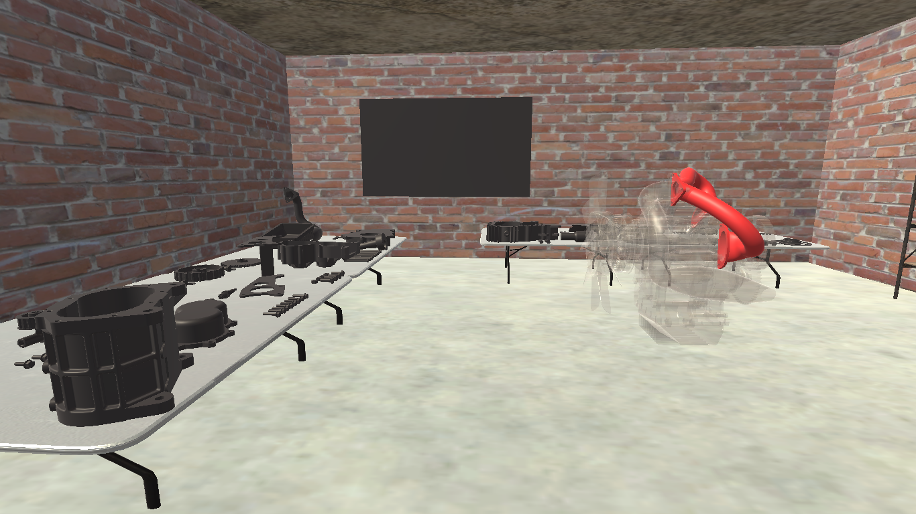
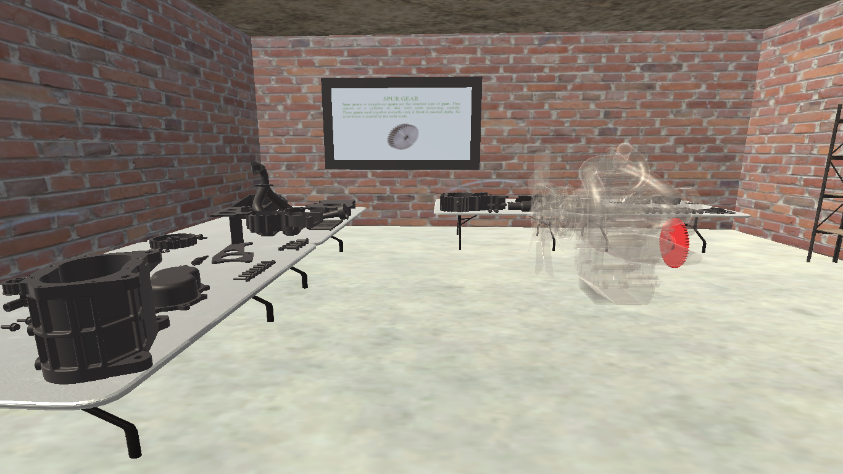
STEP-1
STEP-2
STEP-3

Slide 20
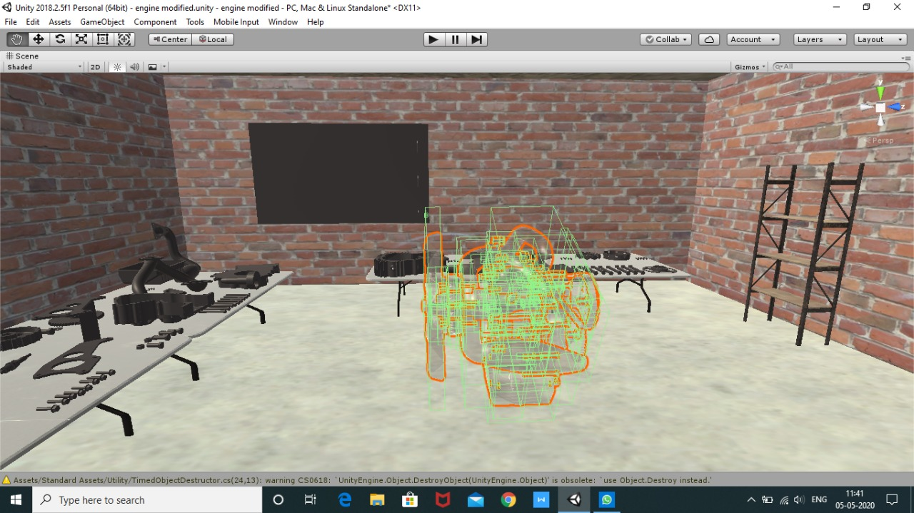
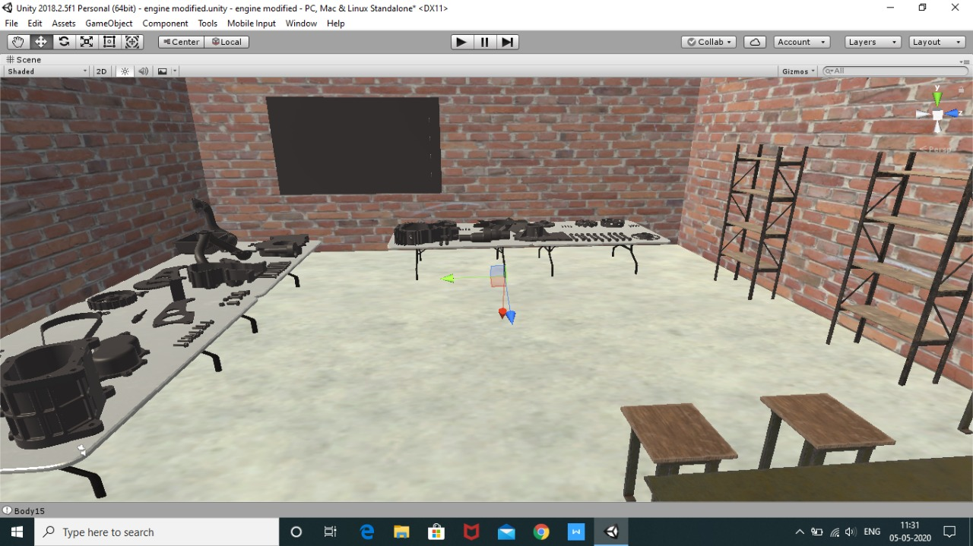
STEP 4
STEP 5

Slide 21
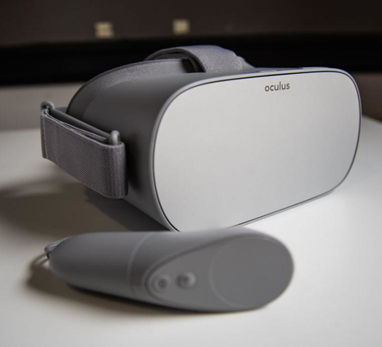
DEPLOY: OCULUS GO
The Oculus Go is a standalone virtual reality headset developed by Facebook Technologies in partnership with Qualcomm and Xiaomi. The Go is an all-in-one headset, meaning it contains all the necessary components to provide virtual reality experiences and doesn't require a connection to an external device to use.
Set Up Oculus Go Device
Download the Oculus companion app
for Android or iPhone and set up the user
account.
Go to settings in your app and select
the type of Oculus device you want to pair from the list.

Slide 22
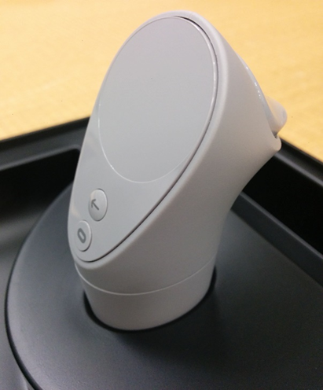
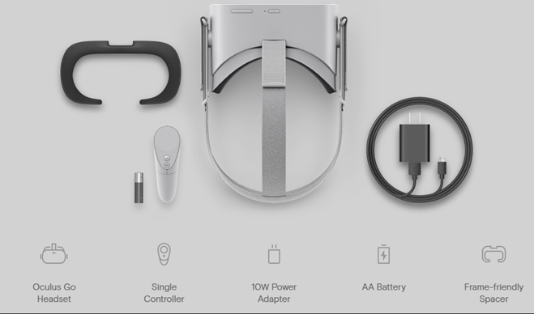
Follow the on-screen instructions to pair the device and its controllers.
Follow the in-VR instructions to complete the generic device settings.
Project Settings
Enable Virtual Reality (VR) Support
Define Quality Settings
Build Settings
Inside the Box Controller

Slide 23
SPECIFICATIONS OF OCULUS GO
Developer | Facebook Technologies, Qualcomm, Xiaomi
Manufacturer | Facebook Technologies
Type | Virtual reality headset
Generation | First generation
Release date | May 1, 2018
Lifespan | 2018-Present
Introductory price | US$199 (32 GB model) US$249 (64 GB model)
Units sold | See Sales section
Operating system | Android 7.1.2
System-on-chip used | Qualcomm Snapdragon 821
Memory | 3 GB (LPDDR4)
Storage | 32 GB or 64 GB NAND flash
Display | 5.5" fast-switching LCD (RGB-stripe) 2560×1440 resolution (1280×1440 per eye) 60 to 72 Hz refresh rate 12.67 pixels per degree
Graphics | Adreno 530
Sound | Integrated speakers 3.5 mm headphone jack
Input | non-positional 3DOF tracking
Controller input | Oculus Go controller (primary input device) Bluetooth gamepads (supported by some games)
Connectivity | Micro-USB IEEE 802.11ac Wi-Fi Bluetooth 4.1 (gamepads only)
Online services | Oculus Store
Dimensions | 190 mm × 105 mm × 115 mm (7.48 in × 4.13 in × 4.53 in)
Mass | 468 g (1.032 lb)
Backward compatibility | Most software developed for the Samsung Gear VR
Predecessor | Samsung Gear VR

Slide 24
SCRIPTS:
Select
Drag and Drop
APPLICATION:
VR Application

Slide 25
EXPERIMENTAL RESULTS
Practical in science and engineering areas require high technology, high-cost machines; and with the advancement in virtual reality, it is possible to have virtual labs in remote areas accessed sitting in the office or home of the learner. Virtual reality can assist students to become immersed in a learning environment where they can participate in their learning in a technology-based environment.
Virtual reality is the basis for functional virtual prototyping, which enables engineers to analyze the shape, form, and functional behavior of products in an immersive and interactive virtual environment. Applying this technology greatly improves the communication in product design and product development:

Slide 26
SCOPE FOR FUTURE WORK
In Learning mode, we can integrate Augmented reality and make more interactive and allow learners to focus more on practice instead of just theory, by adding virtual objects to the environment.
In Training mode, to provide more interaction we can add virtual hand gloves, tools (wrench, Pullers etc.) which are used in conventional assembly tasks.
In Self-evaluation mode, add options like giving score at the end of the complete assembly, which gives more game approach to the user.

Slide 27
CONCLUSION
The use of Immersive VR can offer great advantages for learning:
It allows a direct feeling of objects and events that are physically out of our reach.
It supports training in a safe environment avoiding potential real dangers and, thanks to the game approach, it increases the learner’s involvement and motivation while widening the range of learning styles supported.
This VR based learning could help the learners to understand and memorize them better.

Slide 28
REFERENCES
Gilson Giraldi, R. S. (n.d.), “Introduction to virtual reality”,https://doi.org/10.1109/VR.2003.119117
Jean Thilmany, ”Walkabout in another world".(2000)
Pantelidis, V. S. (1993). Virtual reality in the classroom. Educational Technology, 33(4), 23-27.
Nooriafshar, M., Williams, R., &Maraseni, T. N. (2014), “The use of virtual reality in education", The American Society of Business and Behavioral Sciences (ASBBS) 2004 Seventh Annual International Conference, (September).
Chris Christou. (2010), “ Affective, interactive and cognitive methods for e-learning design: creating an optimal education experience”.

Slide 29
6. Xue-qin Chang, Dao-hua Zhang, Xin-xin Jin. (2016), “Application of Virtual Reality Technology in Distance Learning”: Vol 11, International Journal of Emerging Technologies in Learning (iJET) – eISSN: 1863-0383
7. A.C. Boud, C. Baber, S.J. Steiner, “Virtual Reality: A Tool for Assembly”,[11].
8. Smutny, P., Babiuch, M., & Foltynek, P. (2019). A Review of the Virtual Reality Applications in Education and Training. 2019 20th International Carpathian Control Conference (ICCC). DOI:10.1109/carpathiancc.2019.8765930

